Slide 1

Network Game 2.0
Server edition
Advanced Network Game – © Securitymadein.lu – M. Farcot – Licensed Under CC BY SA 4.0
Hack4Kids@Deloitte
Notes:
1

Slide 2
Outline/Plan/Agenda
Basic
Network
IP address
IP packet
DNS
Ping Command
http/https
Advanced
SERVER GAME
Advanced Network Game – © Securitymadein.lu – M. Farcot – Licensed Under CC BY SA 4.0
Notes:
Today we will talk about network, network admin easy commands, and network security
2

Slide 3

Network/ Réseau/ Netzwerk
Advanced Network Game – © Securitymadein.lu – M. Farcot – Licensed Under CC BY SA 4.0
Notes:
How to represent a network? How could we imagine a map of the Internet? As kingdoms of web services perhaps?
3

Slide 4
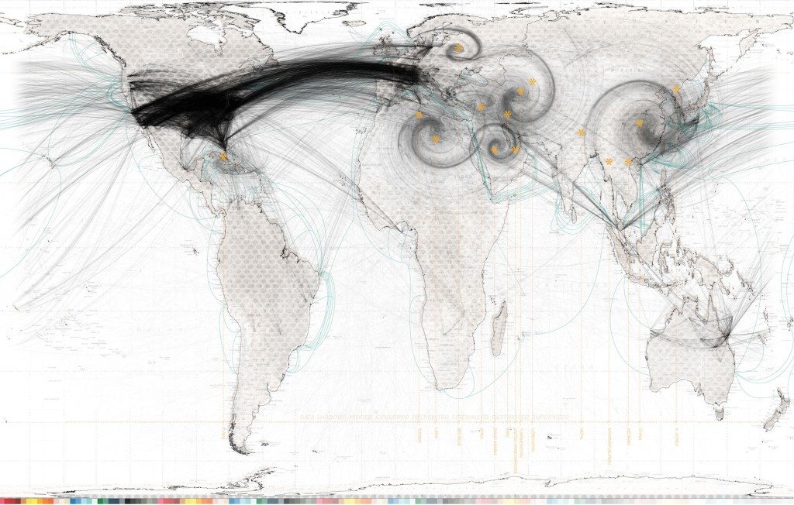
Network/Réseau/Netzwerk
Advanced Network Game – © Securitymadein.lu – M. Farcot – Licensed Under CC BY SA 4.0
Notes:
Or perhaps as information flows connecting various equipments all over the world?
4

Slide 5
Network/Réseau/Netzwerk
Advanced Network Game – © Securitymadein.lu – M. Farcot – Licensed Under CC BY SA 4.0
Notes:
This will be our network.
TO DO: Select 4 routers (2.0.0.1, 31.3.224.1, 37.25.128.1, 78.141.128.1).
Identify 8 other players (or give several DNS to same kids if not enough attending).
1 kid is the USER
1 Kid is www.schoolnews.lu, the web site to which the user wants to connect
1 kid is www.kopfbook.lu, the worldwide social network
1 kid is www.cool.lu, a video broadcasting platform
1 kid is www.picture.fr, a picture serving platform
1 kid is adverts.co.uk, an advertisement platform
1 kid is click-baits.fr, a fishy web site generating a lot of traffic
1 kid is www.analytics.de, a web tracking company
1 kid can play several servers
If more kids are present, distribute among groups “other user” role. They will not participate directly in last game, but can provide support.
Assign to the routers various IP addresses in their ranges (one IP per player). Routers distribute IPs.
Now all children have an IP address – For children which are routers X.X.X.1 (important role, they are the mailman for exchanging messages). All exchanged messages must pass by a router.
NOTE FOR GAME: Game manager will be responsible for motivating the children. You should ask them to send as many messages as they can.
5

Slide 6



IP address/ Adresse IP/ IP-Adresse
+352 2 44 44-200
Advanced Network Game – © Securitymadein.lu – M. Farcot – Licensed Under CC BY SA 4.0
Luxembourg
XXX.XXX.XXX.XXX
Notes:
An IP address is like a telephone number
6

Slide 7
IP packet/ Paquet IP/ IP-Paket
Source (From)
Destination (To)
Meta Data
Metadonnées
Metadaten
Advanced Network Game – © Securitymadein.lu – M. Farcot – Licensed Under CC BY SA 4.0
Time
Protocol
Length
+ Content
Notes:
As you can see, a network packet is composed of metadata and Content.
7

Slide 8
IP packet/ Paquet IP/ IP-Paket
Advanced Network Game – © Securitymadein.lu – M. Farcot – Licensed Under CC BY SA 4.0
Notes:
As you can see, a network packet is composed of metadata + content
EXERCISE 1 – take a message (simple paper). Write your IP address in the FROM field, the destination in the TO field, & your message. Pass the message to your local router that will delivers it to its destination (first do a local game, all children working together).
8

Slide 9







DNS = Domain Name Server
Advanced Network Game – © Securitymadein.lu – M. Farcot – Licensed Under CC BY SA 4.0
170.194.156.208
www.deloitte.lu
DNS
(Domain Name Server)
Notes:
Explain DNS is like a phone book.
9

Slide 10
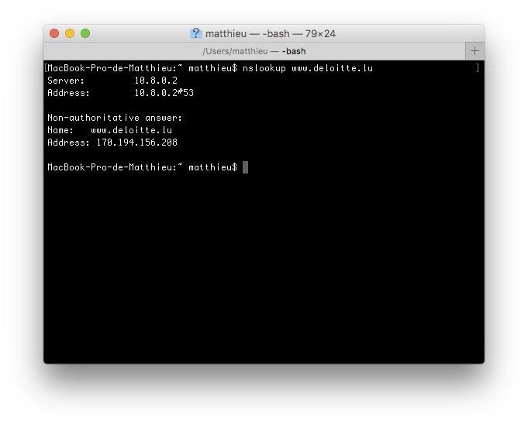
DNS = Domain Name Server
Advanced Network Game – © Securitymadein.lu – M. Farcot – Licensed Under CC BY SA 4.0
Notes:
EXERCISE 2 – Fill list of the IPs on a whiteboard with corresponding names of children (This will be our DNS system). From now on, children can refer to themselves (From field) or the receiver of the message (To field) using an IP address or a name.
DNS search will be the responsibility of router.
10

Slide 11





Ping Game/ Jeu du Ping/ Ping-Spiel
Advanced Network Game – © Securitymadein.lu – M. Farcot – Licensed Under CC BY SA 4.0
PING?
OK!
Notes:
What is a ping command? Allows a computer to see if a target is online or offline.
EXERCISE 3 –take a message (simple paper). Write your IP or DNS (if applicable) in FROM field, the destination in the TO field (IP or DNS), & a PING message. Pass message to router. Router delivers (first do a global game, all children working together). PING target must respond PONG to initial sender
11

Slide 12
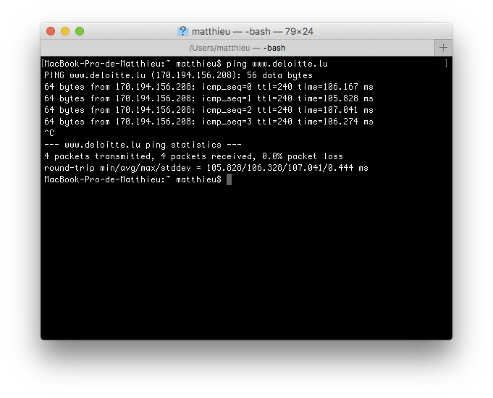
Ping Game/ Jeu du Ping/ Ping-Spiel
Advanced Network Game – © Securitymadein.lu – M. Farcot – Licensed Under CC BY SA 4.0
Notes:
What is a ping command? Allows a computer to see if a target is online or offline.
As you can see, ping is in milli-seconds. Insist on that fact with children.
12

Slide 13
HTTP/HTTPS
Advanced Network Game – © Securitymadein.lu – M. Farcot – Licensed Under CC BY SA 4.0
Notes:
Problem of messages == clear text (like a postcard). Use SSL/TLS is like putting the postcard in an envelope.
13

Slide 14





HTTP/HTTPS
☑
Advanced Network Game – © Securitymadein.lu – M. Farcot – Licensed Under CC BY SA 4.0
☒
Notes:
Problem of messages == clear text (like a postcard). Use SSL/TLS is like putting the postcard in an envelope.
EXERCISE 4 –Children choose if they send encrypted messages or not. Encrypted messages are put in an envelope, with metadata written on the envelope.
14

Slide 15
Server Game / Jeu du serveur/ Server Spiel
Advanced Network Game – © Securitymadein.lu – M. Farcot – Licensed Under CC BY SA 4.0
Load the page
Notes:
Let’s see how this all works… for real.
The goal is to fill in (Load) completely the website
All exchanges will use HTTPS (envelopes)
Make the USER stand up in front of team
The USER sends a message to schoolnews.lu, requesting a connection
Schoolnews.lu sends back the template of the website, containing the core content, but with lot of content missing (put the browser window so that everybody can see it)
The USER sends a message to analytics.de, requesting a page load.
Analytics.de sends back script section to USER (analytics.de/script1)
USER sends three more requests: Picture.fr/School_1.png, Cool.lu/video.mp4 and KopfBook.lu/User22 to respective servers (www.picture.fr, www.cool.lu and www.kopfbook.lu)
Picture.fr sends back picture to USER
Cool.lu sends video to USER
Cool.lu sends a message informing download from USER to analytics.de
KopfBook sends a message to analytics.de informing of a connection of the USER
KopfBook sends a message to adverts.co.uk informing of a connection of the USER with login User22
KopfBook sends image for single sign to USER
Analytics.de sends a message to click-baits.fr requesting a banner
Click-baits.fr acknowledges that request by answering an ok message to analytics.de
Click-baits.fr sends banner to USER
Analytics.de sends a message to Kopfbook.lu, requesting information on USER22 eating habits
Kopfbook.lu answers to analytics.de that USER likes Apples
Analytics.de sens a message to adverts.co.uk requesting an apple advertisement
adverts.co.uk acknowledges that request by answering an ok message to analytics.de
adverts.co.uk sends image of apple advertisement to USER
15

Slide 16
Server Game / Jeu du serveur/ Server Spiel
Advanced Network Game – © Securitymadein.lu – M. Farcot – Licensed Under CC BY SA 4.0
Notes:
Discuss about traces left online by USER
Role of Kopfbook.lu
How advertisements are pushed online
16

